Slide 1



Sacred Heart College Yarrawonga
2025 YEAR 7
Information Night
RESPECT
HOSPITALITY
SERVICE
COMPASSION

Slide 2


COLLEGE CAPTAINS
Sienna Ross & Dimity Connell
COURAGE
JUSTICE
CARE FOR OUR COMMON HOME
RESPECT

Slide 3
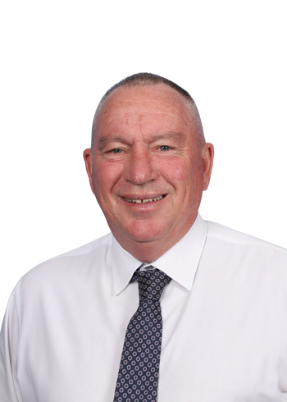
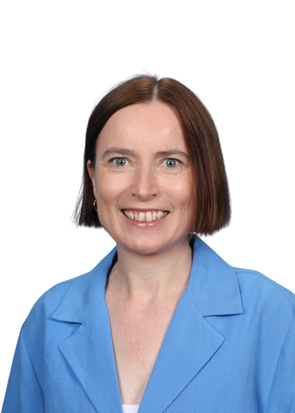
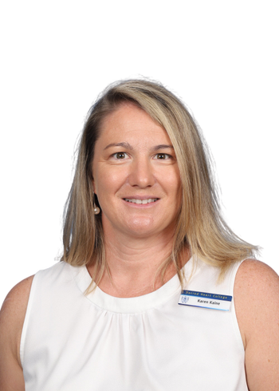
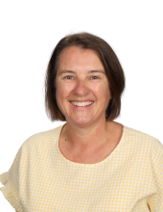
2025 PRINCIPAL TEAM
Lew Nagle
Principal
Fleur Linehan
Deputy Principal
Karen Kaine
Deputy Principal
Jenny Loughnan
Business Manager
RESPECT
HOSPITALITY
SERVICE
COMPASSION

Slide 4
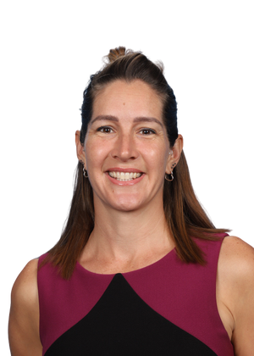
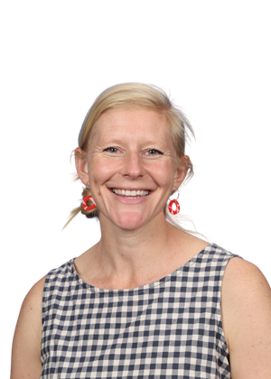
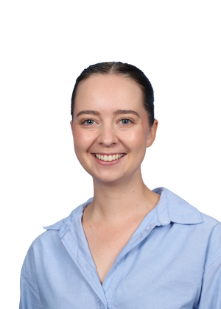
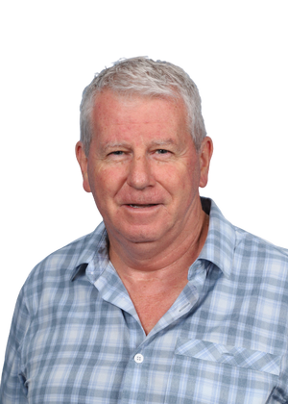
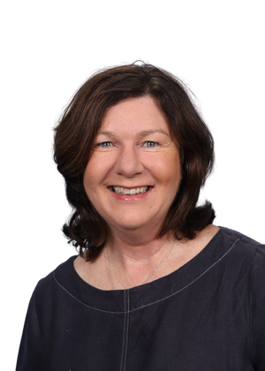
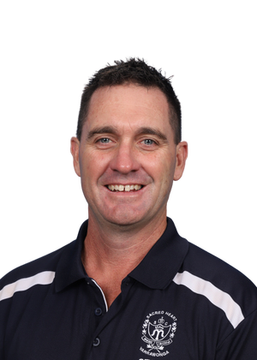
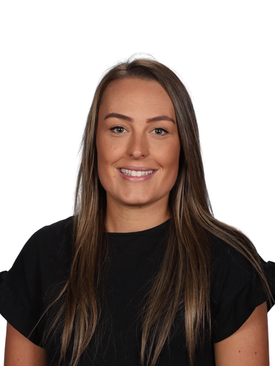
LEARNING & TEACHING TEAM
Tanya O’More
Maths
Tess Macrae
English
Kaysee Gray
Science
Michael Ross
RE
Leah Wilson
Humanities
Jane Morris
Art/Tech
Noel Skehan
PE Health
COURAGE
JUSTICE
CARE FOR OUR COMMON HOME
RESPECT

Slide 5

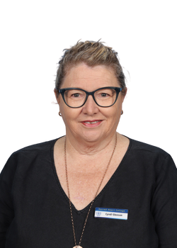
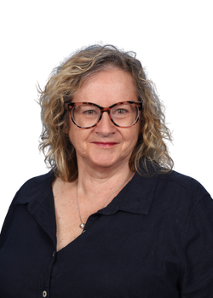
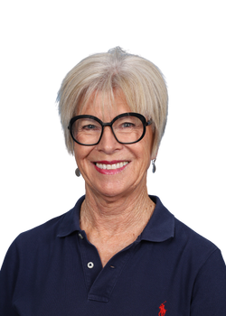
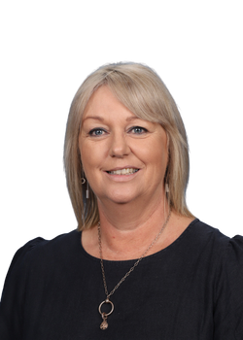
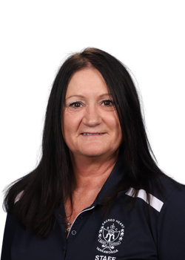
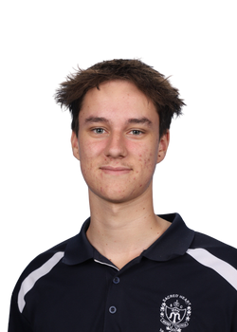
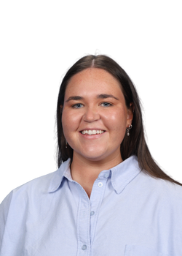
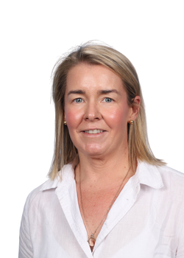
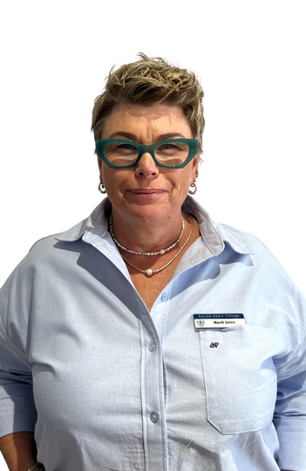
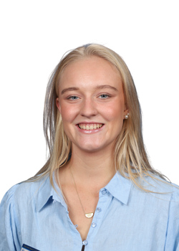
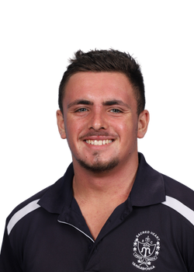
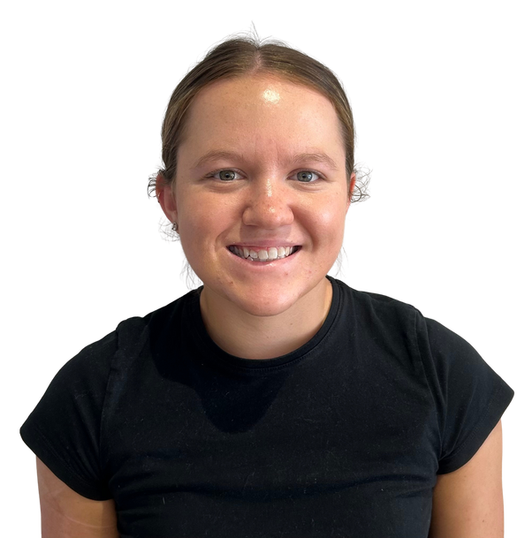
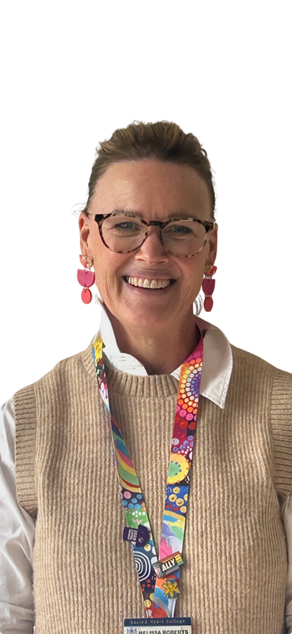
LEARNING SUPPORT
Cyndi Gleeson
Learning Support
Leader
Robyn Lucas
Learning Support
NCCD Admin
Margie Duncan
Colleen Binnie
Rachel Dodd
Kyle Rigoni
Meg Marshall
Georgia Cummins
Mardi Jones
Ella Skehan
Jye Brennan
Sienna Mullavey
Melissa Roberts
RESPECT
HOSPITALITY
SERVICE
COMPASSION

Slide 6

SCIENCE OF LEARNING
COURAGE
JUSTICE
CARE FOR OUR COMMON HOME
RESPECT

Slide 7
CURRICULUM SUBJECTS
English
Religious Education
Mathematics
Science
Humanities
Italian
History
Geography
Economics & Business
Civics & Citizenship
Health & Physical
Education
Digital Technologies
Woodwork, Art,
Food Tech
Literacy
RESPECT
HOSPITALITY
SERVICE
COMPASSION

Slide 8
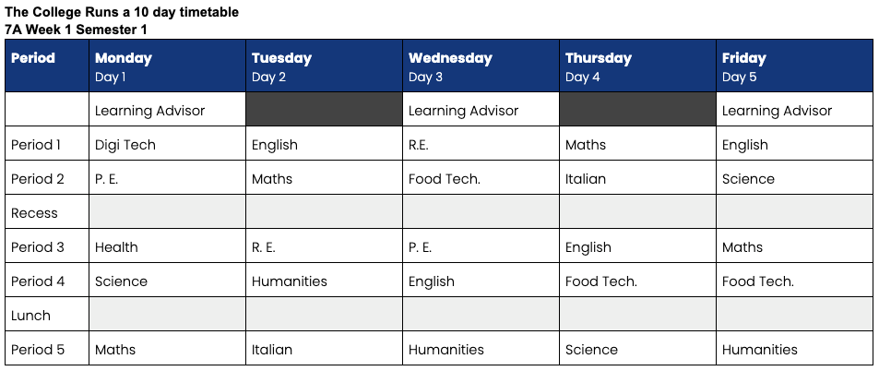
STUDENT TIMETABLE
COURAGE
JUSTICE
CARE FOR OUR COMMON HOME
RESPECT

Slide 9
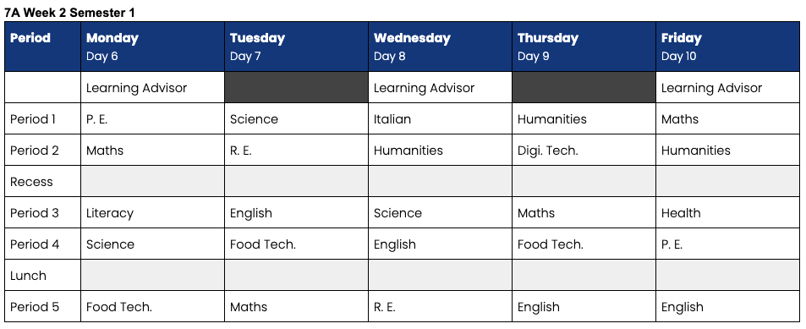
STUDENT TIMETABLE
RESPECT
HOSPITALITY
SERVICE
COMPASSION

Slide 10
STUDENT TIMETABLE
FAQ’s
1. How long do classes run for?
2. What is Learning Advisor?
3. Do students pick electives?
4. What curriculum do you teach in Year 7-10?
COURAGE
JUSTICE
CARE FOR OUR COMMON HOME
RESPECT

Slide 11

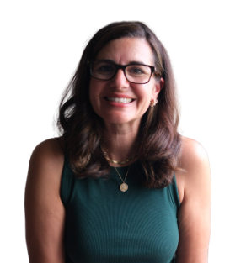

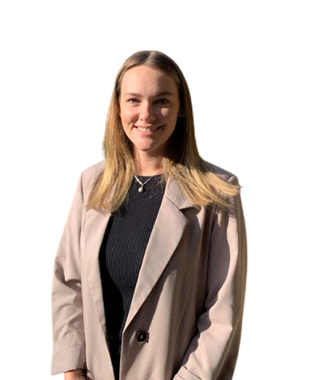
WELLBEING PROGRAMMES
Internal & external counselling
SHCY/NESAY Partnership Model of Support
Evidence based model to achieve social, emotional,
behaviour & academic improvements
Karen Kaine
Brenda Spilva
SWPBS Positive Education School
PEERS social skills, LLL for positive relationships & communication, online safety & cyber bullying programmes, Pat Cronin Foundation - violence prevention, Road Safety - Looking After Your Mates
Year Level Specific Programmes
Casey May
RESPECT
HOSPITALITY
SERVICE
COMPASSION

Slide 12
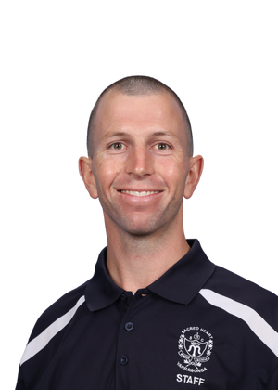
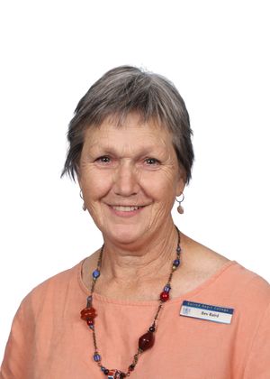
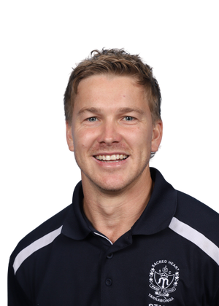

YEAR 7 LEADER
Reed Bonat
LEARNING ADVISOR
Jane Morris
Bev Baird
Jacob Adkins
Ruby Carmody
COURAGE
JUSTICE
CARE FOR OUR COMMON HOME
RESPECT

Slide 13
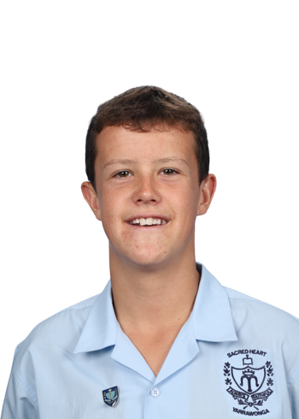
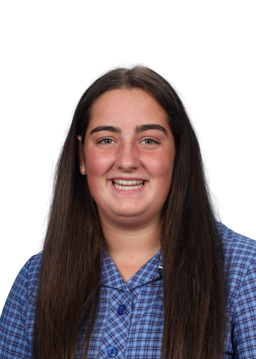
YEAR 7
COLLEGE CAPTAINS
Charlie Bourke
Sophie Archibald
Lockers
Subjects
Student leadership opportunities
Homework Club
Timetable
Sports Day
Year 7 Camp 2025
RESPECT
HOSPITALITY
SERVICE
COMPASSION

Slide 14
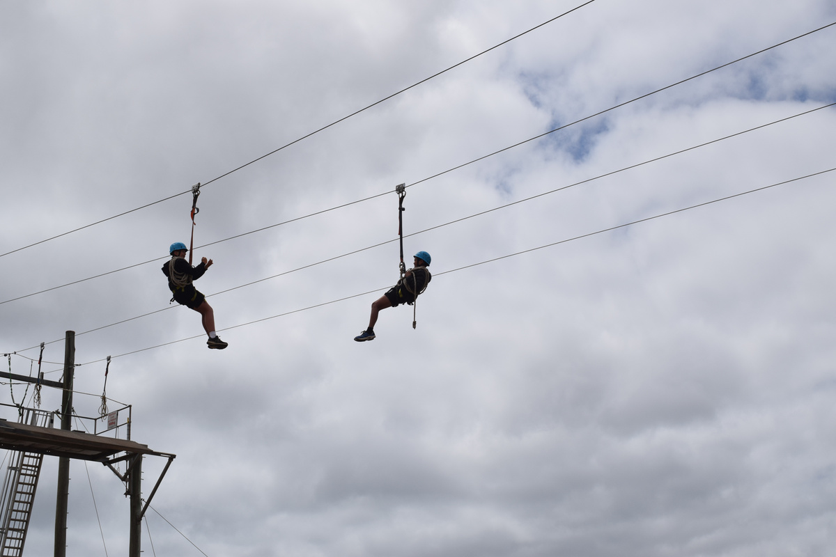
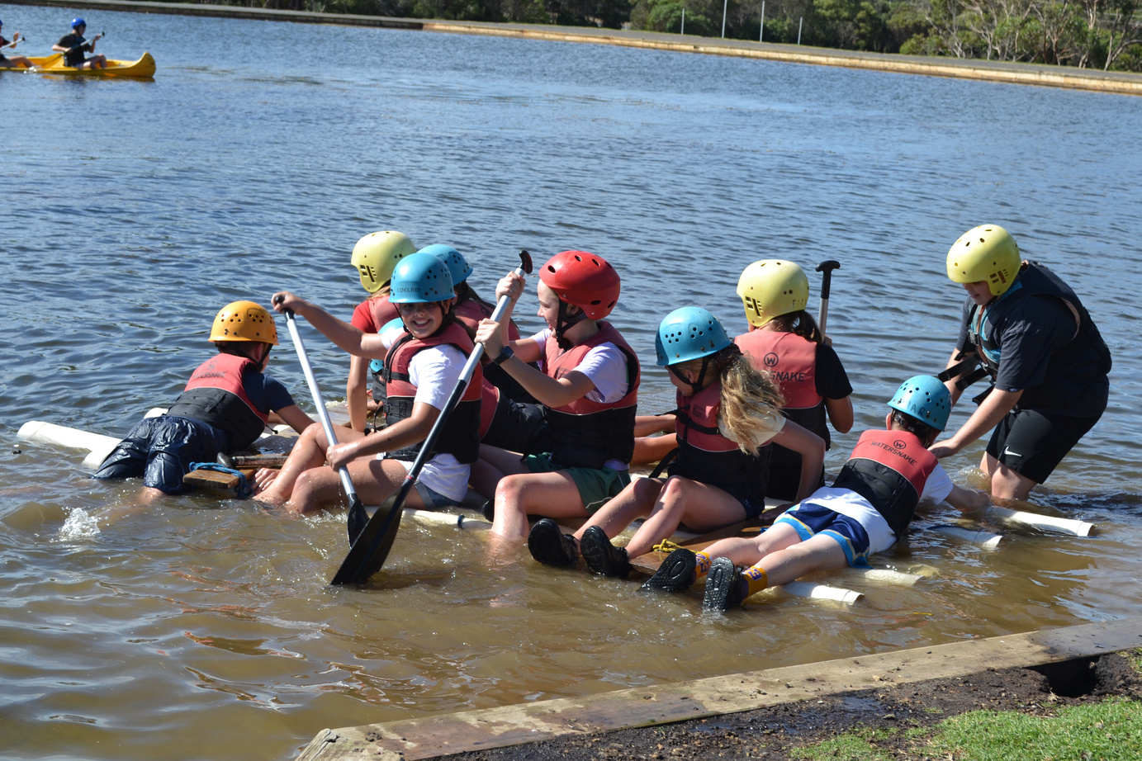
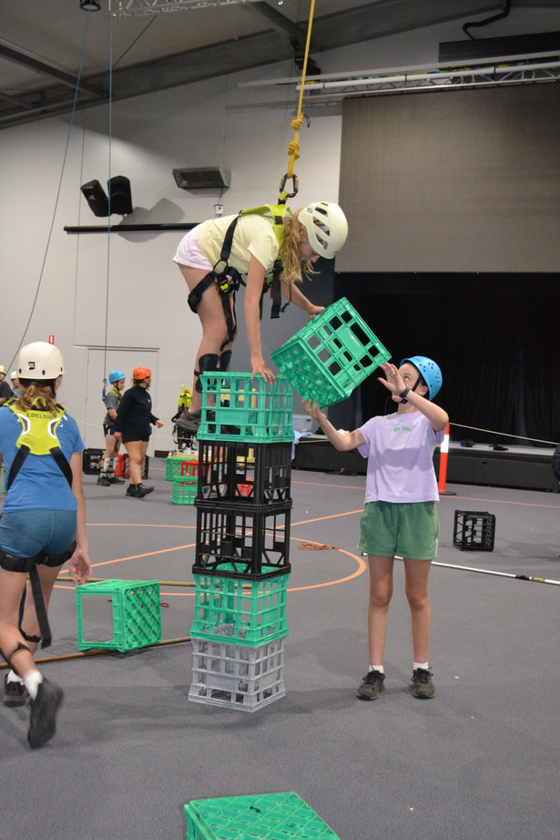
YEAR 7 CAMP
PHILLIP ISLAND ADVENTURE RESORT
When: Wednesday 28th - Friday 30th January 2026
SURFING
GIANT SWING
CANOEING
FLYING FOX
ROPES COURSE
ROCK CLIMBING
CRATE CLIMBING

Slide 15
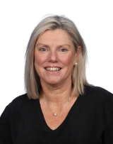
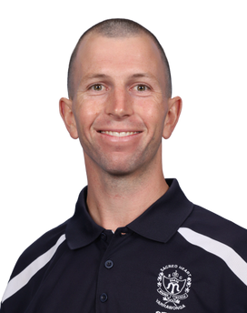
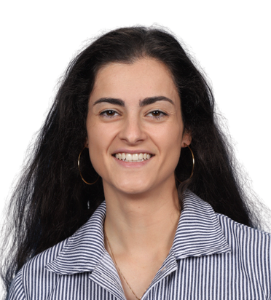
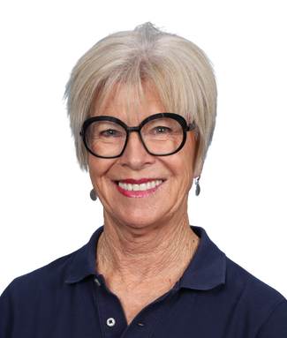
HOMEWORK CLUB
Year 7 -10 Every Wednesday in the Library
Open from 3:10pm - 4:45pm
STUDENTS MUST SIGN IN AND OUT
START Building Great Habits
Homework club is a FREE program to help your child with their homework, catch up if they are behind or help them get ahead. Completing homework or reviewing work is an important skill.
Homework club gives students an opportunity to review, practice and develop skills in a supportive environment.
One to one or small group support.
Providing valuable guidance and tutoring from experienced educators.
RESPECT
HOSPITALITY
SERVICE
COMPASSION

Slide 16

TRANSITION
Transition Programme
  Three Tuesday afternoon sessions to participate in cross curriculum activities prior to full day transition on Tuesday 9th December Term 4
COURAGE
JUSTICE
CARE FOR OUR COMMON HOME
RESPECT

Slide 17
ENROLMENT SCHEDULE
  Enrolments Open
  Applications Due
  Interviews Commence
  Enrolment Acceptance
- Now
- 31st May, 2025
- 3rd June, 2025
- 26th July. 2025
*Applications received after 31st May, may go on a waiting list
COLLEGE TOURS
  Wednesday 28th May - 12pm & 1:30pm
Please contact the College for further booking enquiries
COURAGE
JUSTICE
CARE FOR OUR COMON HOME
RESPECT

Slide 18


THANK
YOU

